Slide 1

Test Automation - Allstate Mobile Application

Slide 2
Objectives
At the end of this session, participants will be able to understand:
Initial Steps to begin with Mobile Test Automation
Registry Files
Perfecto Overview
Finding Device Details from Perfecto
Uploading Builds to Perfecto Repository
Finding X Paths using Perfecto
Executing a Test

Slide 3
Initial Steps
Initial Steps to Begin With Allstate Mobile Application Test Automation:
Clone the project repository
Import the project to Eclipse

Slide 4
Registry files:
These are the Registry files that come as part of Mobile projects:
applicationRegistry.xml – Contains build information
cloudRegistry.xml – Contains access credentials to cloud instance
deviceRegistry.xml – Contains device information

Slide 5
cloudRegistry.xml
The Cloud registry controls access to our various cloud instances.
All access information and credentials are stored here for use by the system
Provide Perfecto User name and Password in the highlighted fields below:
<cloud name="Allstate" userName="ABCD@allstate.com"
password="ABCD1234” hostName="allstate.perfectomobile.com"
proxyHost="rdc-proxy.allstate.com” proxyPort="8080" grid="local"
providerType="PERFECTO" />

Slide 6
applicationRegistry.xml
Application registry contains the build information.
Upload the test build to Perfecto repository and provide the location in the fields
highlighted below:
<application name="Allstate" appPackage="com.allstate.view”
bundleId="com.Allstate.AllstateMobile.ENT" url=""
androidInstall="PUBLIC:Allstate_MasterApp\Agila\release_12.4.0.870_20180809-1404_DEBUG.apk"
iosInstall="PUBLIC:Allstate_MasterApp\Agila\release_12.4.0.1324_20180808-1135_TESTING.ipa"/>

Slide 7
deviceRegistry.xml
Device Registry is to specify the details of the device to be picked up for test.
It represents a set of device criteria specifying a single device type.
Provide device details in the highlighted fields. These details could be taken from
perfecto. Active =”True” -> by giving ‘True’ we are selecting the device to run the
script.
<device name="iPhone-6S" os="iOS" manufacturer="Apple" model="iPhone-6S" active="true"
driverType="APPIUM" id="F83266DC74B5C8E57BB5D78A62D3E3A60C62743B" />
<device name="Pixel" os="Android" manufacturer="Google" model="Pixel" active="false"
driverType="APPIUM" id="FA77S0306150” />

Slide 8
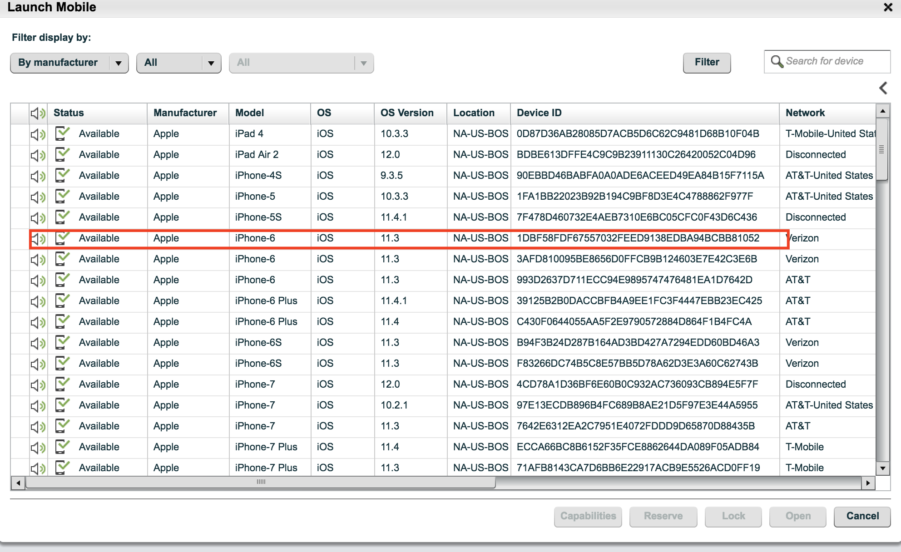
Finding Device Details from Perfecto:
Log into perfecto
Click ‘Launch Mobile’
From the list of devices, choose one for the test
Get Model, OS, Manufacturer and Device ID
Notes:
The HTML alt attribute provides text for screen readers

Slide 9
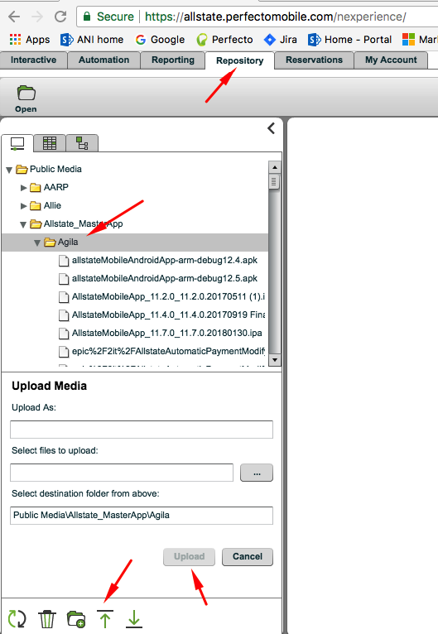
Uploading Build to Perfecto Repository:
Download the latest build to your machine
Log into perfecto
Select ‘Repository’ tab
Choose the location and upload
Notes:
The HTML alt attribute provides text for screen readers

Slide 10
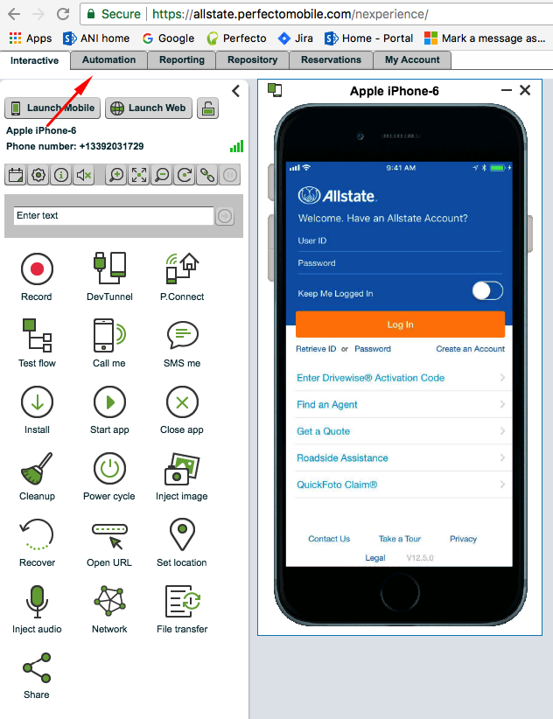
Finding X Paths using Perfecto:
Open a device in Perfecto
Launch the App
Navigate to Automation tab
in Perfecto
Notes:
The HTML alt attribute provides text for screen readers

Slide 11
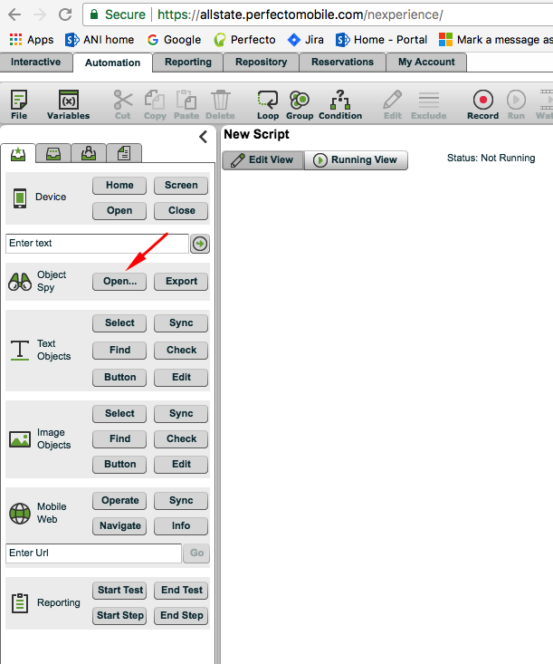
Choose Object Spy
Object Spy window opens and all the elements on the page will be highlighted.
Notes:
The HTML alt attribute provides text for screen readers

Slide 12
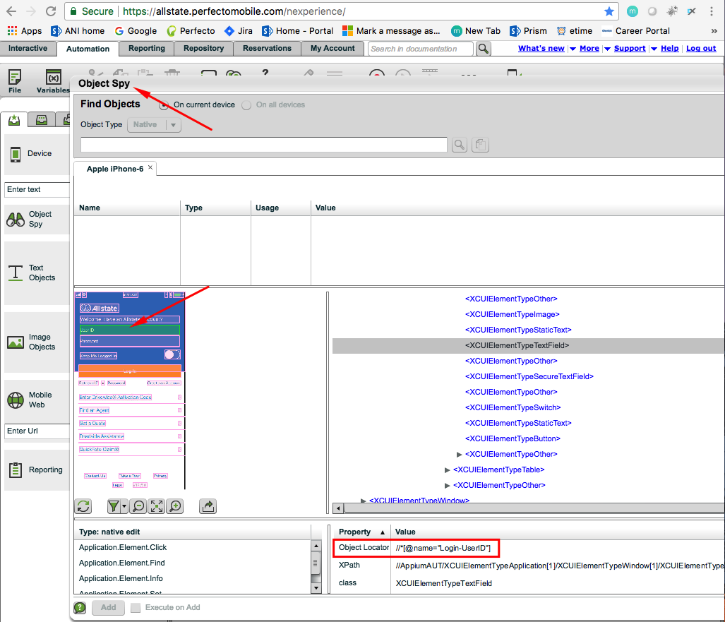
Select the element under test on top left pane-> Xpath will be displayed on the bottom right pane.
Notes:
The HTML alt attribute provides text for screen readers

Slide 13

Thank You

